Slide 1
Gateway to Computer Science
This lecture is the introduction given to CS15 Students
We present it in CS2 with the goal of interesting a few of you to consider further study in CS
CS 2 has had a long history of convincing past students to pursue CS as a concentration with great success!

Slide 2
CSCI0150
(AKA CS15)
A Gateway to Computer Science

Slide 3
Computer Science (1/2)
CS15 is a start to understanding computer science
for your own intellectual interest
for its enrichment of other fields
for its combination of scientific, engineering, art and design concepts and practices, and as a “mode of thought” – “computational thinking”

Slide 4
Computer Science (2/2)
IT, or information technology including CS, is key to the “knowledge economy”
Some examples of CS in action, to illustrate the breadth of our field and its applications, follow

Slide 5
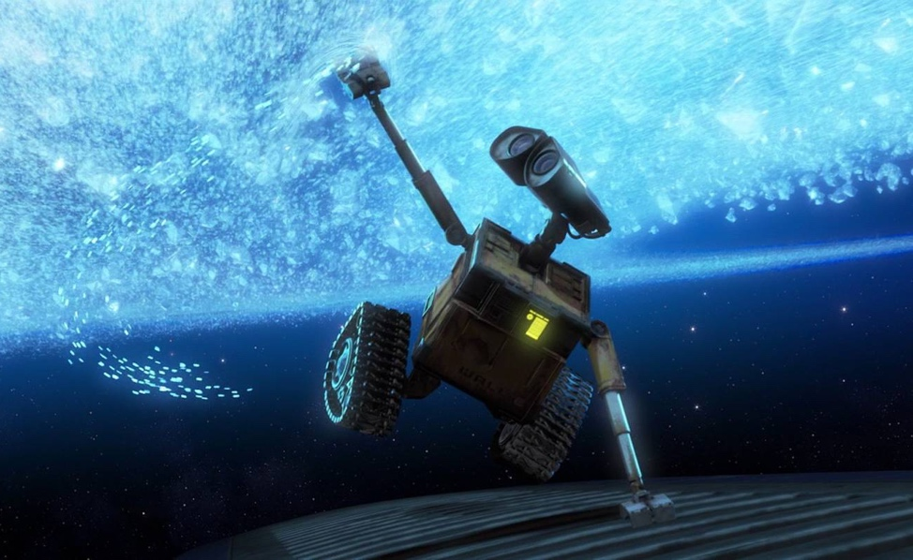
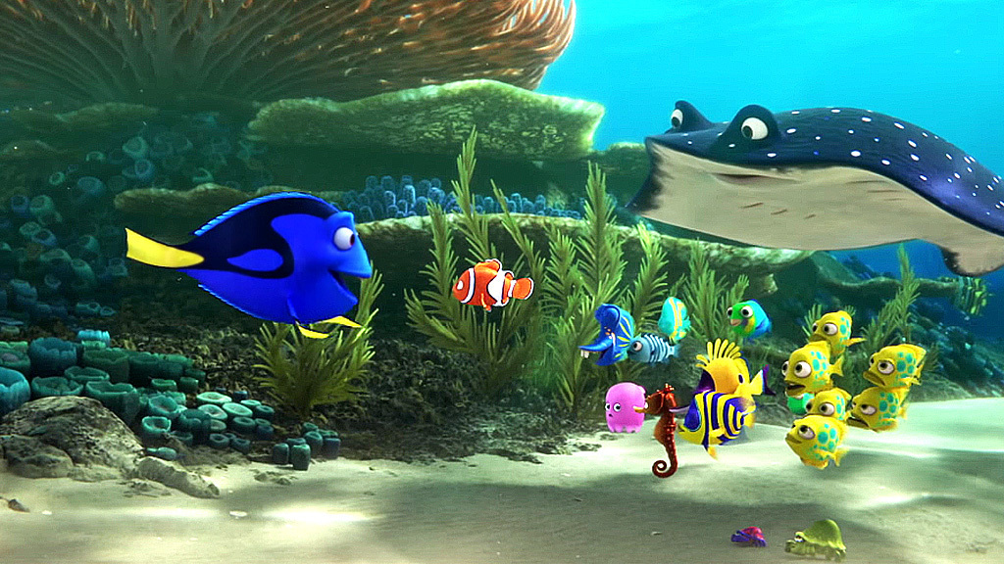
Stunning Special Effects
WALL-E
Finding Dory

Slide 6
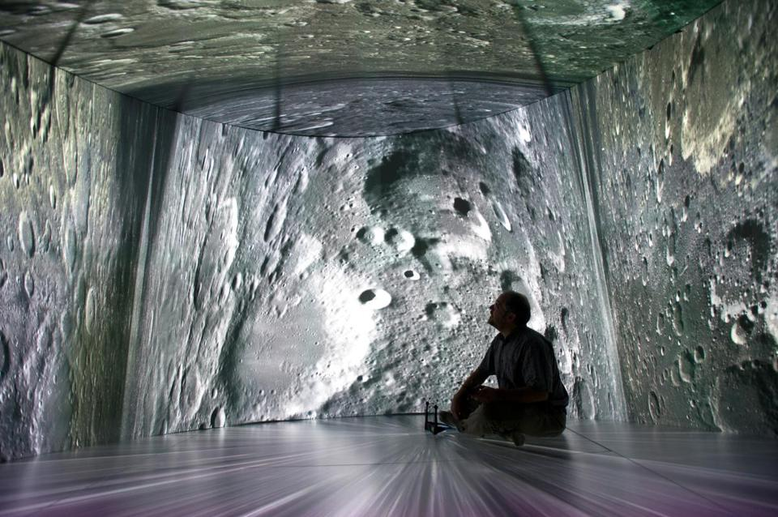
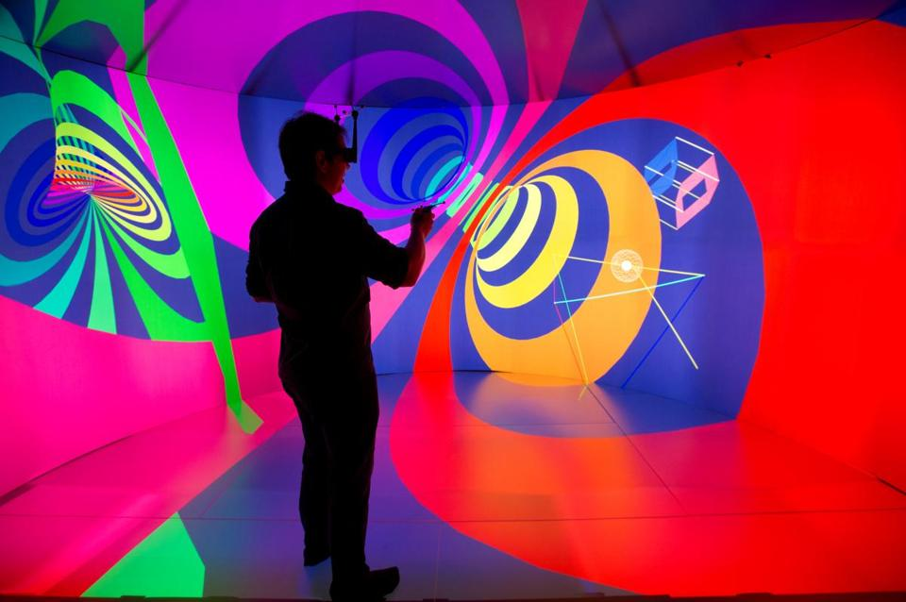
Immersive Virtual Reality
Researchers can create fully immersive 3D environments via head-tracked stereo glasses, enabling realistic “field geology” on Mars!
A state-of-the-art new “Cave”, the YURT (YURT Ultimate Reality Theater), at 180 George Street about to be generally available
much higher quality (e.g., 100Mpixels) and much more comfortable than Oculus Rift and other VR gear
but way more expensive!

Slide 7
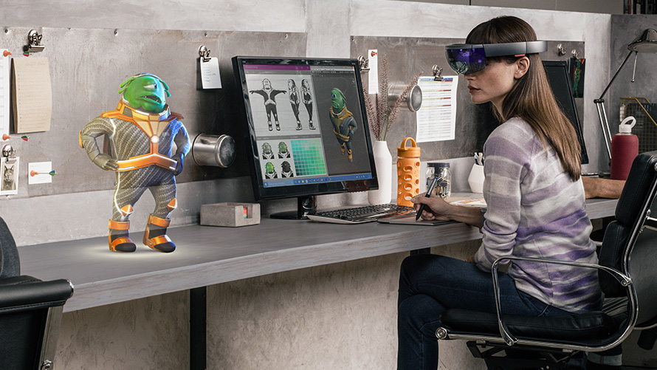
Augmented Reality
Creates virtual elements “on top of” the real world, blending a digital reality with an existing one!
Example: Microsoft HoloLens
special glasses that create a mixed reality out of holograms
still in development

Slide 8
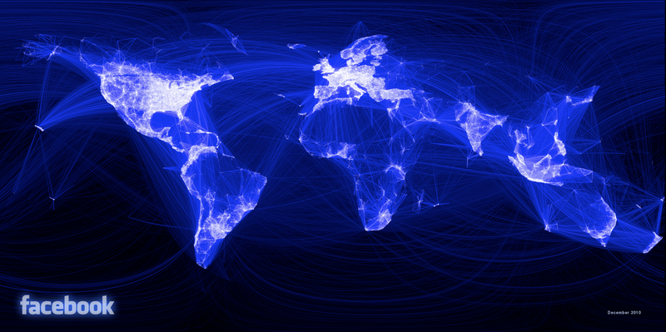
The Internet and Social Networks
Facebook
1.5 billion active users worldwide
over 70 billion pieces of content (links, pictures, etc.) shared each month
150,000 messages sent per minute
open source API allows users to write their own Facebook applications

Slide 9
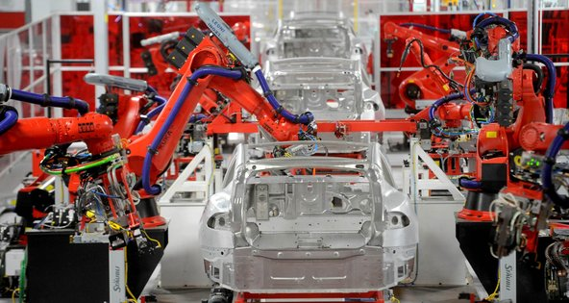
Dilemmas of the Digital Age (1/4)
Machines continue to replace human labor and decision-making
machines have increased human productivity while reducing demand for routine, repetitive jobs
as middle-skilled, task-intensive jobs disappear, income gap widens
but new jobs are being created, old jobs “upskilled” to be more interesting
education is key to economic survival

Slide 10
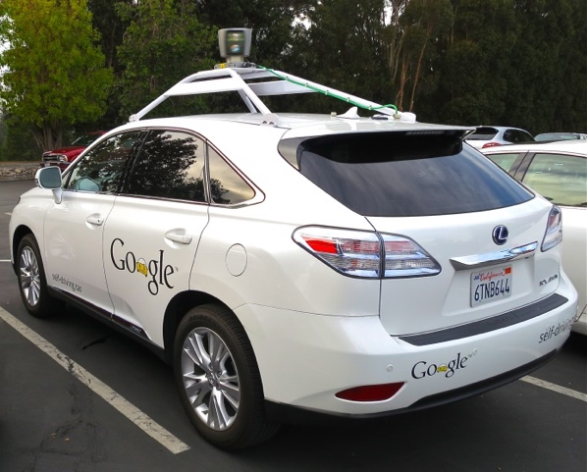
Dilemmas of the Digital Age (2/4)
Dangers of yielding too much control to algorithms, some too complex to be understood by most people
instability in the stock market due to trading algorithms
self-piloting vehicles (autopilot on planes, driverless cars…)
nuclear power plants
Cyberfraud, Cybercrime, Cyberwarfare
offense has the advantage over defense
schools in Russia, China, North Korea (at least) teach hacking…we’ve gone well beyond amateur hacking
Brown is strong in cybersecurity technology and policy

Slide 11

Dilemmas of the Digital Age (3/4)
Big Data
“data mining”, “machine learning”, statistics-based algorithms for detecting patterns, anomalies, etc.
search
real-time language translation
face recognition
gesture recognition for user interfaces
credit card fraud detection
crime and terrorism anticipation
but what about privacy?!?
Spielberg’s “Minority Report” with Tom Cruise

Slide 12

Dilemmas of the Digital Age (4/4)
Big data & personal privacy
information now more accessible than ever
threat to privacy represented by increasing storage of personally identifiable information – is there any real “anonymous data”?!?
Google search results influencing voter decision-making
NSA/Snowden Controversy; what about Google, Facebook, Microsoft and their data collection and use of that data – digital stuff is permanent, and you have no control over how it is used (Sun’s Scott McNealy – “privacy is dead, get over it!”)
Need an educated government, citizenry

Slide 13


Slide 14











Slide 15



Slide 16
Q: Why is this happening?

Slide 17


Slide 18
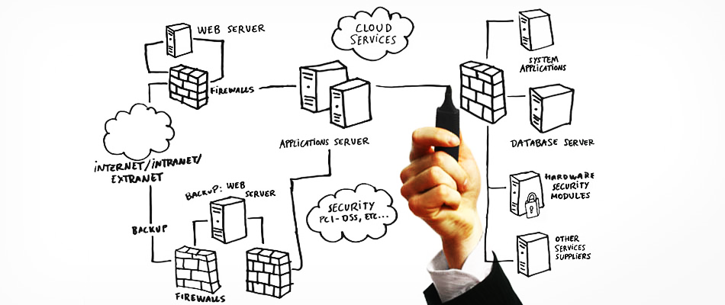

Slide 19


Slide 20






Slide 21
Algorithms & ToC
Mathematics
Crypto
Systems
Politics
Law

Slide 22
Millionaire!

Slide 23
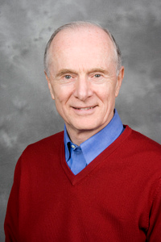
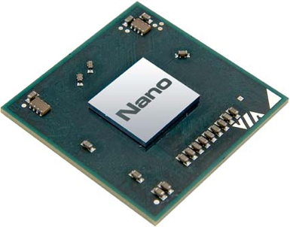

Computer Science at Brown Works on Hard Questions (1/6)
What technologies will help to shrink the size of computers?
How can we make computers more secure?
What policies will reduce cybercrime and avoid cyberwar?
John Savage

Slide 24
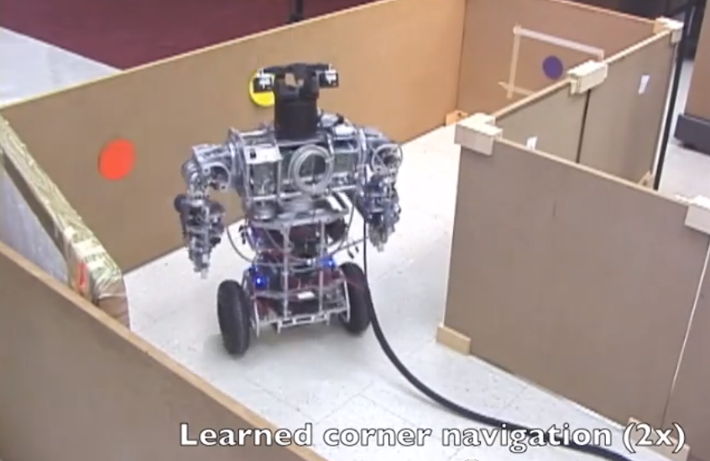
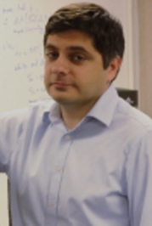
Computer Science at Brown Works on Hard Questions (2/6)
How can we build intelligent, autonomous, general-purpose robots capable of completing a variety of tasks?
Intelligent Robots
George Konidaris

Slide 25
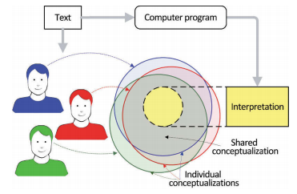
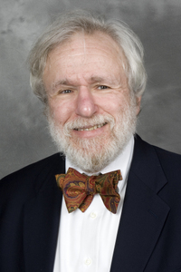
Computer Science at Brown Works on Hard Questions (3/6)
How can computers understand language to answer questions and hold conversations?
Natural Language Understanding
Eugene Charniak

Slide 26
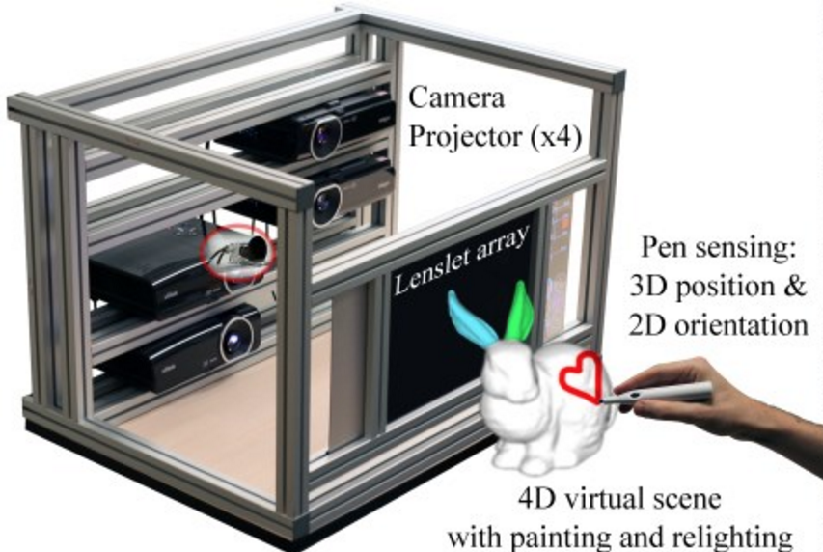

Computer Science at Brown Works on Hard Questions (4/6)
How can graphics, vision, and interaction techniques further our ability to edit and explore the visual world?
Graphics, Vision, and Interaction
James Tompkin

Slide 27
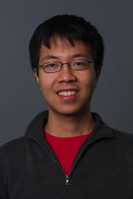
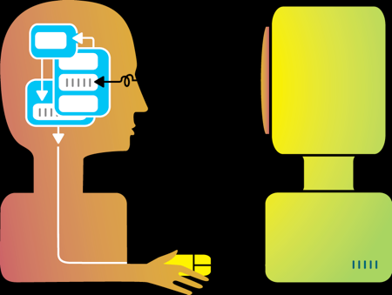
Computer Science at Brown Works on Hard Questions (5/6)
How can we understand and model the way humans interact with computers?
Human-Computer Interaction
Jeff Huang

Slide 28
Computer Science at Brown Works on Hard Questions (6/6)
How do we build new programming languages?
How can we improve domains like security and networking?
How can we improve teaching computer science?
Pyret
Shriram Krishnamurthi

Slide 29
CS: So Much More Than Programming! (1/2)
Computers are our only universal machine, through the magic of software…
Programming is a means to an end, much like mathematics is…but they are both also fascinating topics in their own right!
Big push to learn how to “code”, but there is no “royal road” to programming or CS – it requires serious, sustained effort

Slide 30
Art & Design
CS: So Much More Than Programming! (2/2)
graphics
Computational Biology
systems
(graphical) user interfaces
Computational Economics
theory
distributed and cloud computing
programming
e-books
algorithms
Computational Finance
robotics
modeling
AI
computers
Digital Humanities
Digital Storytelling
Engineering
CS
Math

Slide 31











Why Should You Study Computer Science?
For fun and intellectual excitement
A really exciting era is just beginning
CS still a young discipline, computers just starting to act intelligently
Fundamental “mode of thought”
An increasingly important component of all other fields
Plenty of interesting jobs for qualified people, in established companies and start-ups, in research labs and academia

Slide 32
Questions?

